Slide 1
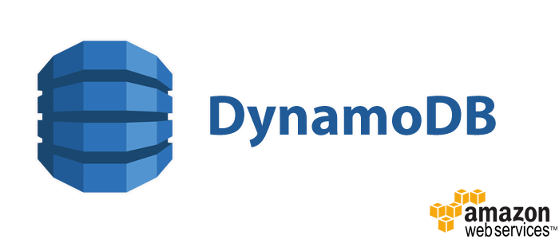
Team Members –
Mayank Gondnale
Mikhil Paul
Shelly Agarwal
Srujan Kadanur Vishwanath

Slide 2
Agenda
What are NoSQL Databases?
SQL vs NoSQL Databases
Amazon’s DynamoDB
Key Features
Data Model
Autoscaling
DynamoDB vs Cassandra vs MongoDB

Slide 3
What are NoSQL Databases?
Non-relational databases with high operational speed
Flexible and easily scalable across thousands of servers
Free form data storage, do not have schemas
No common query language analogous to SQL
Does not stand for “Not SQL”, but for “Not Only SQL”

Slide 4
SQL vs NoSQL Databases
SQL DBs |  | NoSQL DBs
Normalized data into tables with rows and columns | Data Storage | Stores data in JSON-like field-value pair documents
Impossible to add data without a defined Schema | Schema | Data can be added anywhere, at any time
Offers a powerful JOIN clause | JOIN Clause | No JOIN equivalent
Enforces data integrity using foreign key constraints | Data Integrity | The same data integrity options are not available
Dependent on the disk subsystem, optimization is required to achieve very good performance | Performance | De-normalization allows to retrieve all information about a specific item in a single request
Very difficult to scale outside of a single server | Scaling | Simpler data models provides easier scalability

Slide 5
Types of NoSQL Databases
Document Databases – MongoDB, CouchDB
Wide column stores – Bigtable, Hbase, Cassandra
Graph Databases – Neo4j, GraphDB
Key-value stores – Dynamo, Oracle NoSQL DB

Slide 6
Amazon’s Dynamo
A storage system born out of our need for a highly reliable, ultra-scalable key/value database
Targeted at use cases were core to the Amazon e-commerce operation, such as the shopping cart and session service
Ability to scale infrastructure incrementally to accommodate growth in request rates or dataset sizes
Predictability of performance – provided acceptable performance for virtually every customer

Slide 7

Limitations on Dynamo
Did not reduce the operational complexity of running large database systems
The user is responsible for running his/her own Dynamo installations
User need to make complex tradeoff decisions between consistency, performance, and reliability
Users had to focus on running this huge software system than focusing on their applications
Offered fine-grained control, but not simplicity
Ultimately, user had to run the software himself!

Slide 8
Result?
People not using Dynamo and instead adopting Amazon’s SimpleDB which had a tabular interface and flexible data model

Slide 9
Lessons learnt from Dynamo
Need to a database service that takes away the operational headache of managing distributed systems
Not having to update their schemas when their systems evolve makes life much easier.
User desire multi-data center replication, high availability, and rock-solid durability

Slide 10
Solution?
Come up with a new database service which is based on Dynamo but at the same time addresses all its limitations

Slide 11
DynamoDB released! January 2012

Slide 12
Amazon DynamoDB
Fully managed NoSQL database service
Massive and seamless scalability with microseconds response
Initially built for E-commerce platforms such as Amazon itself
Dynamic Autoscaling available to increase and decrease capacity
Uses a Pay-as-you-go model such that user doesn’t pay for unused resources
Notes:
With a managed service, users only interact with the running application itself. You don’t need to worry about things like server health, storage, and network connectivity. With Amazon DynamoDB, AWS provisions and runs the infrastructure for you

Slide 13
Key Features
Simple and cost effective for storing and retrieving data
Data stored on SSDs and replicated synchronously
Flexible – supports both document as well as key-value data structures
Automatically scales capacity up or down as per application’s request

Slide 14








Who uses DynamoDB?
and many more…

Slide 15
Supported Data Types
Amazon DynamoDB supports the following data types:
Scalar types – Number, String, Binary, Boolean, and Null
Multi-valued types – String Set, Number Set, and Binary Set
Document types – List and Map
Document types are meant for representing complex data structures in the form of Lists and Maps

Slide 16
Amazon DynamoDB’s Data Model
Three basic data model units
Tables – Collection of Items
Items – Collection of information
Attributes – Basic units of information
When a table is created, in addition to the table name, a primary key must be specified for the table.
DynamoDB supports two kinds of Primary Keys:
Hash Type Primary Key: If an attribute uniquely identifies an item, it can be considered as Primary. DynamoDB builds a hash index on the attribute to facilitate the uniqueness. A Hash Key is mandatory in a DynamoDB table.
Hash and Range Type Primary Key: This type of Primary Key is built upon the hashed key and the range key in the table
Notes:
Tables are like tables in relational databases, except that in DynamoDB, tables do not have fixed schemas associated with them. Items are like rows in an RDBMS table, except that DynamoDB requires a Primary Key. The Primary Key in DynamoDB must be unique so that it can find the exact item in the table. DynamoDB supports two kinds of Primary Keys:
Hash Type Primary Key: If an attribute uniquely identifies an item, it can be considered as Primary. DynamoDB builds a hash index on the attribute to facilitate the uniqueness. A Hash Key is mandatory in a DynamoDB table.
Hash and Range Type Primary Key: This type of Primary Key is built upon the hashed key and the range key in the table: a hashed index on the hash primary key attribute, and a range sort index on the range primary key attribute. This type of primary key allows for AWS’s rich query capabilities.

Slide 17
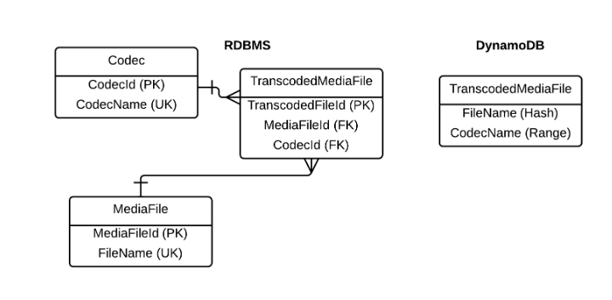
Amazon DynamoDB’s Data Model (contd.)
For example, RDBMS needs 3 tables to store the relationship between a media file and its codec, while DynamoDB does it in one using a primary key consisting of a hash and range key

Slide 18
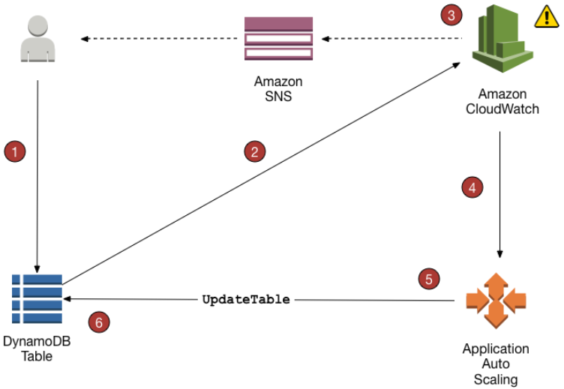
Auto Scaling
Uses the AWS Application Auto Scaling service to dynamically adjust provisioned throughput capacity in response to actual traffic patterns
Enables a table to increase its provisioned read and write capacity to handle sudden increases in traffic
When the workload decreases, the application decreases the throughput so that user doesn’t pay for unused provisioned capacity

Slide 19
DynamoDB vs Cassandra vs MongoDB
DynamoDB vs Cassandra vs MongoDB
 | DynamoDB | Cassandra | MongoDB
Primary Database Model | Document/Key-value store | Wide column store | Document store
License Type | Commercial | Open-source | Open-source
Cloud based | Yes | No | No
Data scheme | Schema-free | Schema-free | Schema-free
SQL | No | Yes | No
MapReduce | No | Yes | Yes
Supported Programming Languages | JavaScript, Python, Perl, Ruby, PHP etc. | C++, JavaScript, Python, Perl, Ruby, PHP etc. | C++, JavaScript, Python, Perl, Ruby, PHP, R, Scala etc.

Slide 20
Typical Applications
E-commerce websites – used to store customer orders, timestamps, order details etc.
Gaming applications – used to store player states and preferences and scalability to easily spread the games to millions of players worldwide. Example- Fruit Ninja, Battle Camp
Mobile Applications – Storing application data and session state
Large scale websites – Session state, user data used for personalization, access control
Application monitoring – Storing application log and event data, JSON data

Slide 21
Thank You!

